Slide 1
Is Talk Cheap?: A Text Based Analysis of Executive Speeches
By: Austin Jang and Amanda McDermott

Slide 2
Literature Review: The Role of Speech in Politics
The Speech Matters: The content of speech has significant
Examples: Jennings et al. 2011, Ambrosio and Androvec 2013, Baturo et al. 2017, CRS 2017,
The Speaker Matters: Leaders and their idiosyncrasies have an impact on politics (maturity, technical knowledge, equanimity). Rhetoric as a signal.
Example: Anderson 1997, Druckman and Holmes 2004, Windsor et al. 2014, Windsor et al. 2018; Jones and Olken 2005, Brender and Drazen 2009, Tepperman 2014.
Nothing Matters: The superstructure imposed on society means that no individual speech or person matters.
Mortenson 2011; the entire subfield of structuralism.

Slide 3
Our Contribution
Evaluation between Domestic and International Audiences
Analysis of states that aren’t the USA. (Little research on China, Russia, no research on Ghana, South Africa, or the Philippines)
Comparative Analysis between countries

Slide 4
Assembly the Dataset
Data Collection
Countries: US, Russia, Philippines, South Africa, China, and Ghana
UNGD data was obtained from the UNGD corpus (Easy)
State of Nation data was web-scraped from a variety of different sources (Not Easy).
Method of Analysis
Word Cloud Analysis
Sentiment Analysis (Positivity, Sentimentality, Economic Words, Security Words)

Slide 5
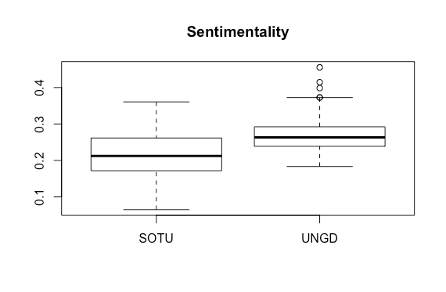
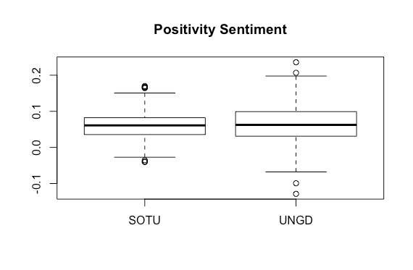
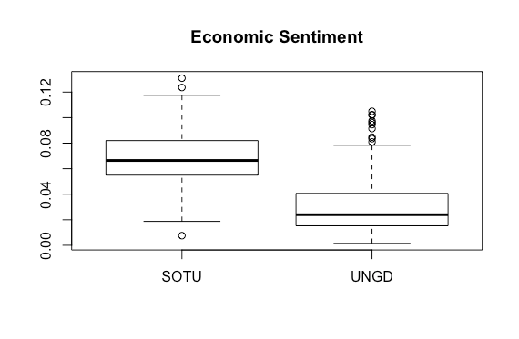
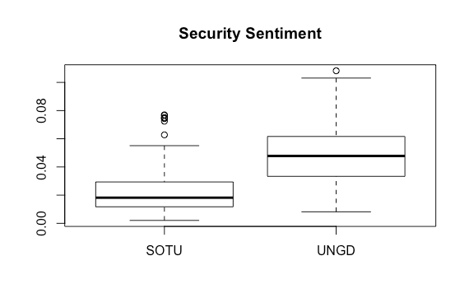
Comparing UN speeches to Domestic Speeches

Slide 6
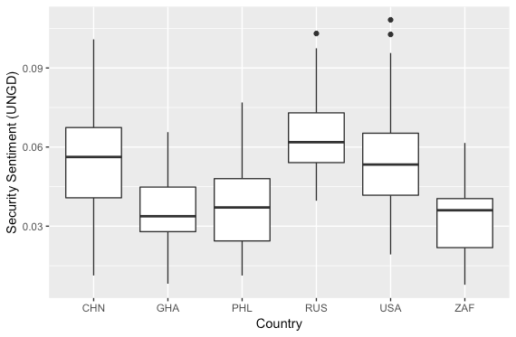
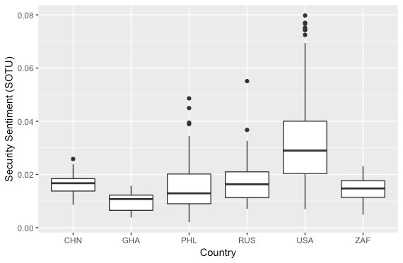
Security “Sentiment” by Country

Slide 7
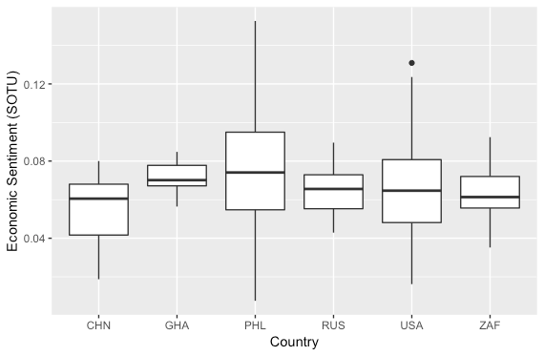
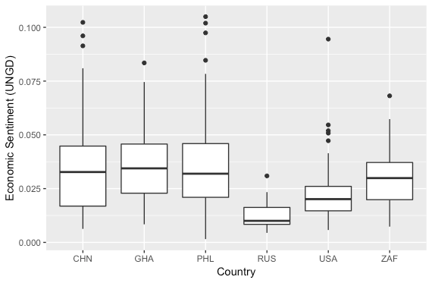
Economic “Sentiment” by Country

Slide 8
EDA: Shiny
https://glacieus.shinyapps.io/wordcloud/

Slide 9
Conclusion

